Slide 1


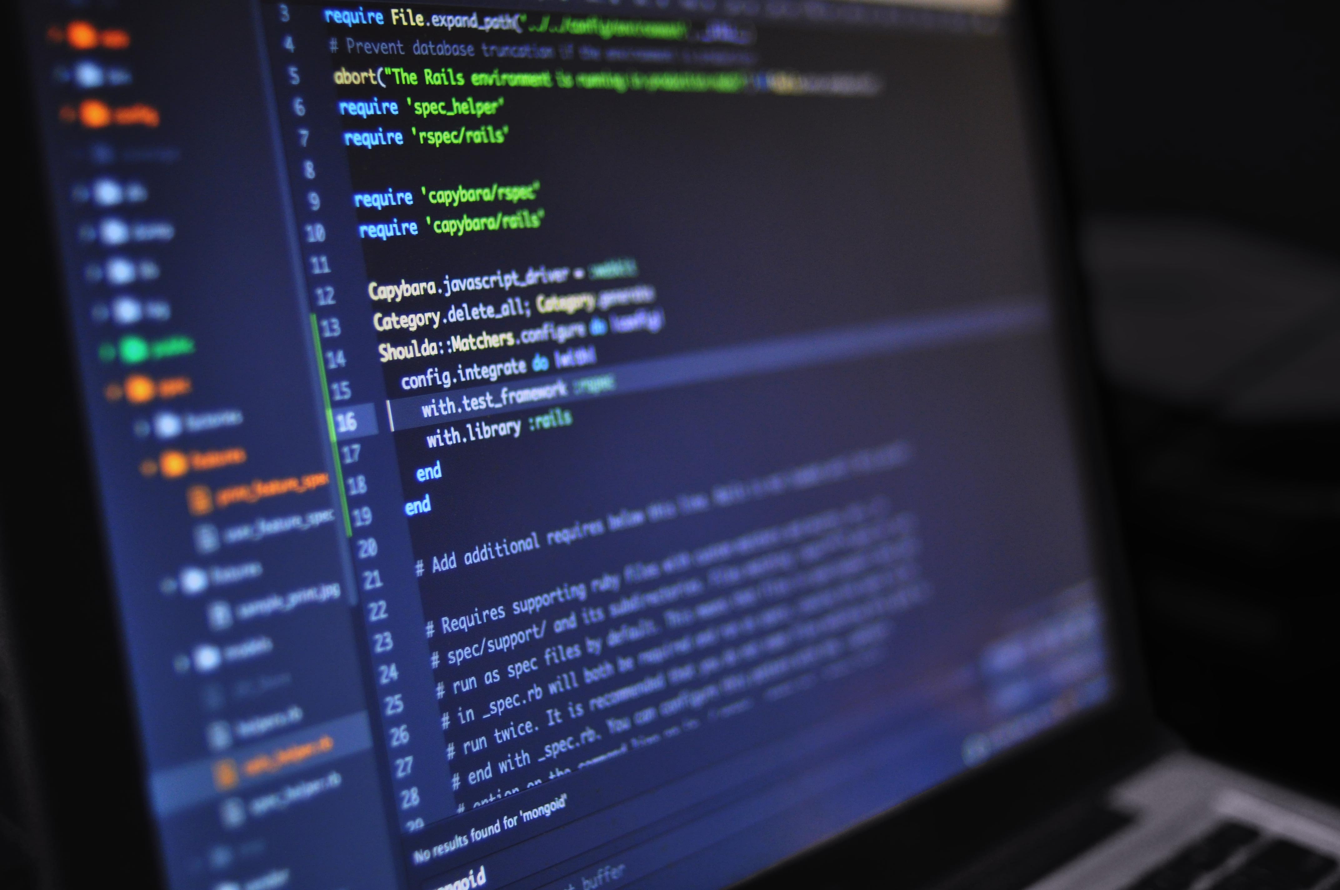
Python for beginners with applications
Write code from scratch in a clear & concise way, through a complete basic course. From beginners to intermediate.
Course 05
Regular expressions
Introduction to Object Oriented Programming
Introduction to Functional programming
Basic GUI creation (Tkinter, custom Tkinter, PyQT/PySide, Figma)
Abdesselam Filali 2026-04-29 18h00 Algiers time

